Slide 1
Of drug cocktails and inhibited enzymatic rates
Why drug cocktails are more effective than single-drug therapies, and how to design them
Harvard Life Sciences Outreach
November 9, 2017

Slide 2
Learning goal and objectives
Learning Goal: To understand how structural and biochemical data can be used to rationally design drugs.
Learning Objectives:
Be able to:
Explain how we quantitatively describe “structural similarity”
Distinguish “competitive” vs “noncompetitive” enzyme inhibition (structurally and biochemically)
Use enzymatic kinetic data to determine which inhibitors would combine to make the best drug cocktail
Notes:
→ Drug design

Slide 3
Learning goal and objectives
Learning Goal: To understand how structural and biochemical data can be used to rationally design drugs.
Learning Objectives:
Be able to:
Explain how we quantitatively describe “structural similarity”
Distinguish “competitive” vs “noncompetitive” enzyme inhibition (structurally and biochemically)
Use enzymatic kinetic data to determine which inhibitors would combine to make the best drug cocktail
Notes:
→ Drug design

Slide 4
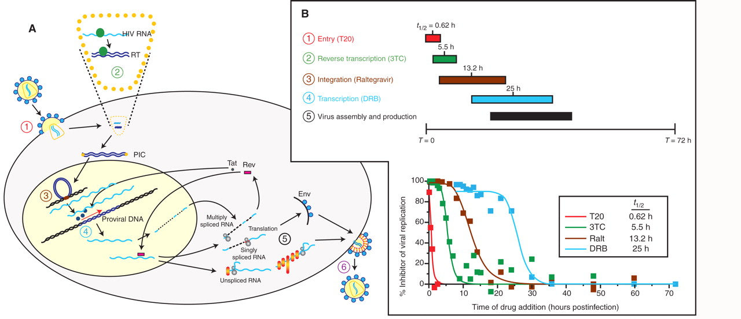
HIV viral replication cycle: how it kills us
1: Reverse Transcriptase
2: Integrase
3: Protease
How we kill it:
HIV uses 3 enzymes, each is a drug target
Arts EJ and Hazuda DJ. “HIV-1 antiretroviral drug therapy.” Cold Spring Harb Perspect Med. 2012 Apr; 2 (4): 1-23.
Notes:
Understand the enemy / The first drugs to treat HIV were developed to inhibit reverse transcriptase, and it involves a pretty cool set of scientific concepts, so I want to spend the rest of our time talking about how to inhibit RT
Identifying distinct steps in HIV-1 life cycle as potential or current target for antiretroviral drugs. (A) Schematic of the HIV-1 life cycle in a susceptible CD4+ cell. (B) Time frame for antiretroviral drug action during a single-cycle HIV-1 replication assay. In this experiment, HIV-1 inhibitors are added following a synchronized inhibition. The addition of drug following the HIV-1 replication step targeted by the drug will result in a lack of inhibition. The time window of drug inhibition provides an estimate for the time required for these replication steps. For example, T30 or enfuvirtide (T20) only inhibits within 1–2 h of infection, whereas lamivudine (3TC) inhibits within a 2- to 10-h time frame, which coincides with reverse transcription. (C) Preclinical, abandoned (normal text), or FDA-approved (bold italic text) inhibitors are listed in relation to specificity of action and drug target.

Slide 5
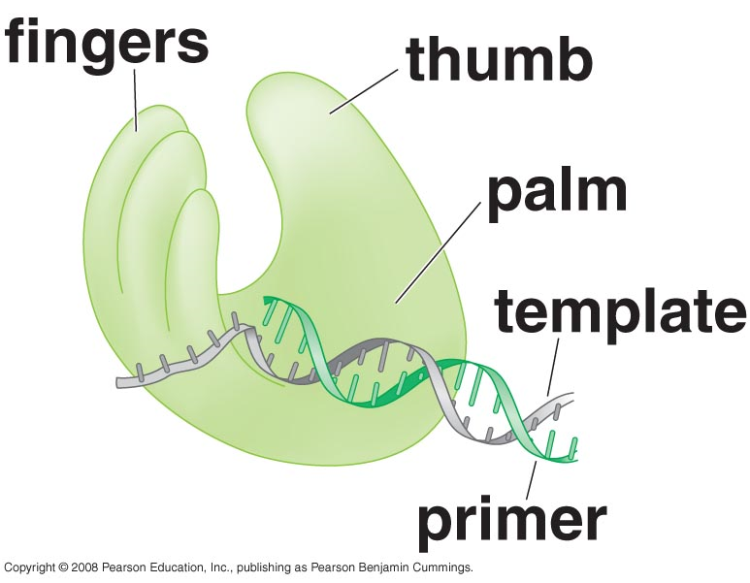
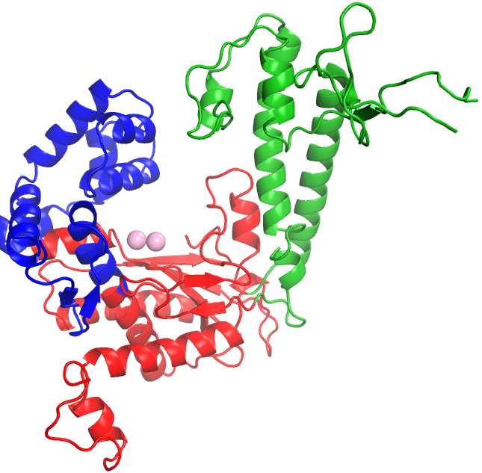
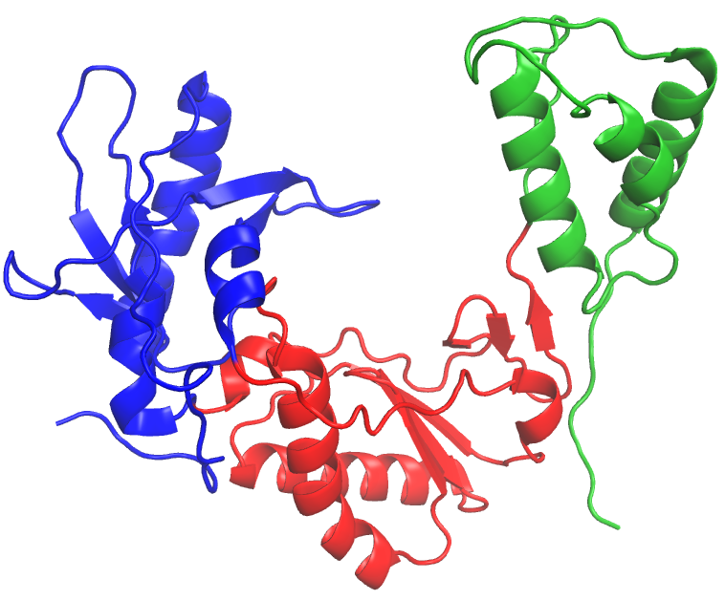
DNA polymerase and HIV RT have similar structures and functions
Thumb
Fingers
Thumb
Fingers
growing strand
Palm
Palm
DNA polymerase
DNA polymerase
HIV Rev Transcriptase
DNA polymerase and HIV reverse transcriptase both catalyze the same reaction:
“substrates” (S)
“products” (P)
Proteins that have similar structures are very likely to have similar functions
→ We can understand HIV RT by studying DNA polymerase (despite very little sequence similarity)
Notes:
Hold up your right hand and cup it a bit. Surprise: you are actually looking at DNA polymerase

Slide 6
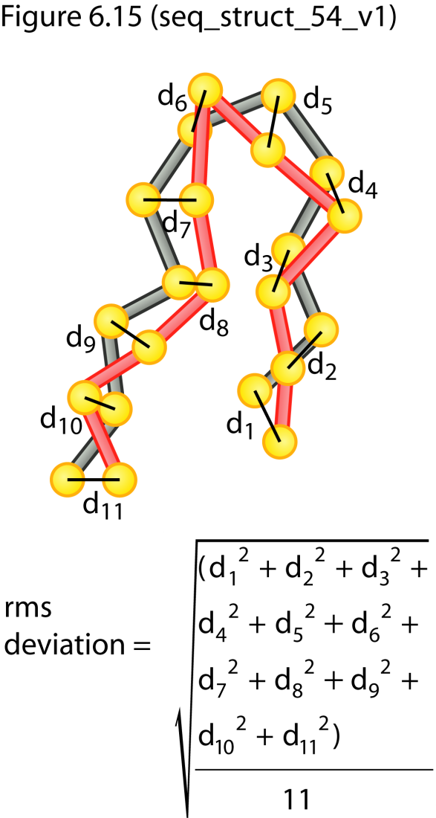
How do we measure how “similar” two structures are?
We use a value called “RMSD”
RMSD = root-mean-square deviation
n = number of atoms
d_{i} = distance between 2 corresponding
atoms i in 2 structures
Typically calculated using Cα carbons (“alpha carbons”)
Figure from The Molecules of Life (© Garland Science 2008)

Slide 7
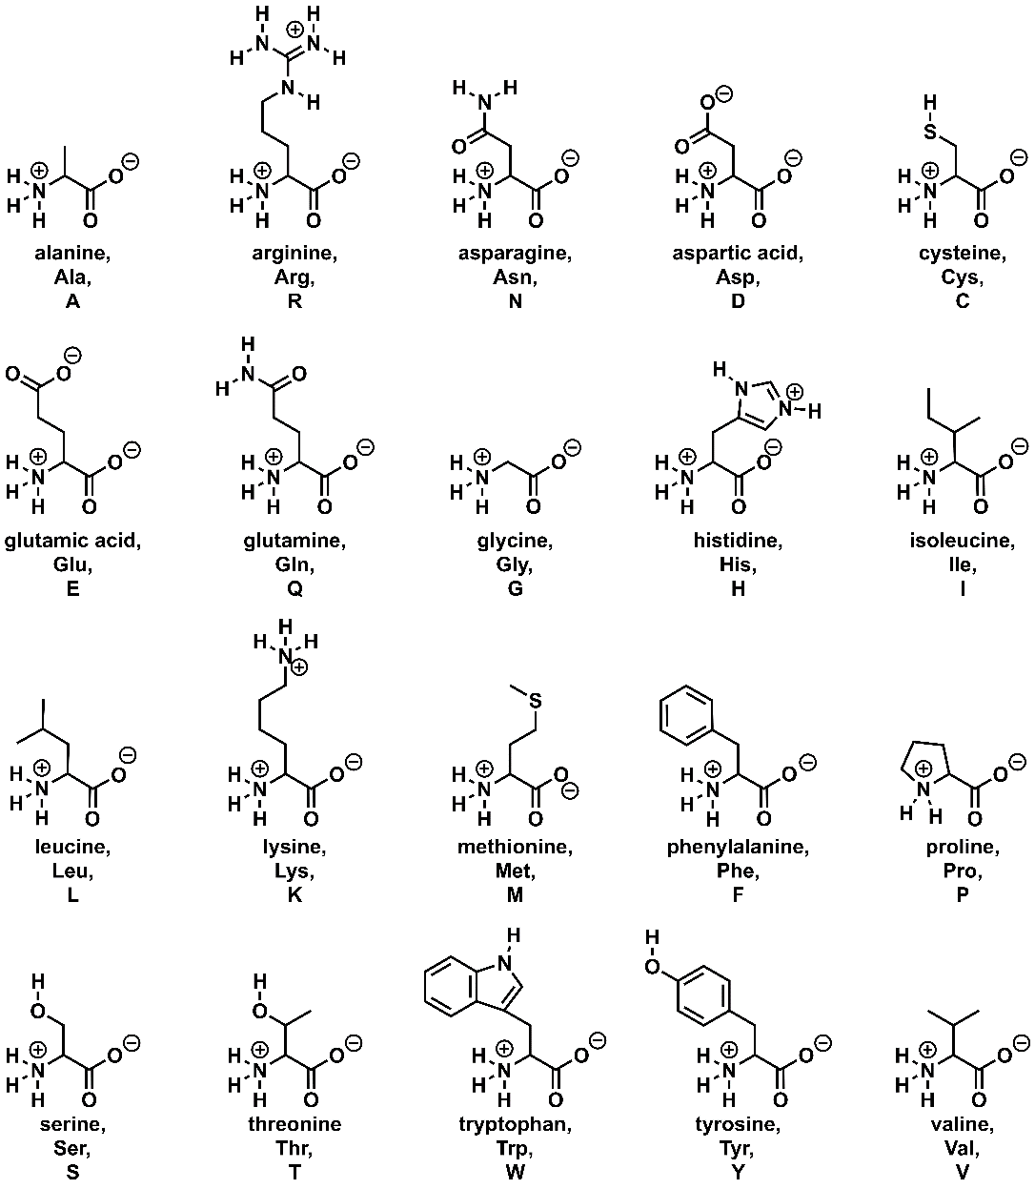
20 amino acids
Cα carbons are:
-present in each amino acid
-in the same position for each amino acid

Slide 8
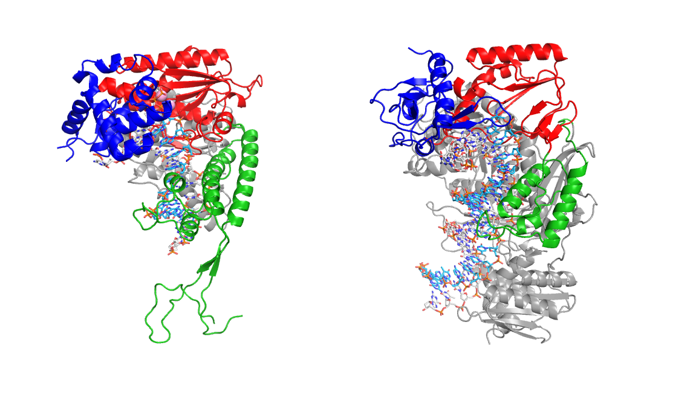
Comparing the structures of DNA polymerase and HIV reverse transcriptase
DNAP_RT.pse
To calculate the RMSD between DNA polymerase and HIV RT, type in: “super DNAP_T7, DNAP_RT”
(units are in Angstroms = 10⁻¹⁰ m)

Slide 9
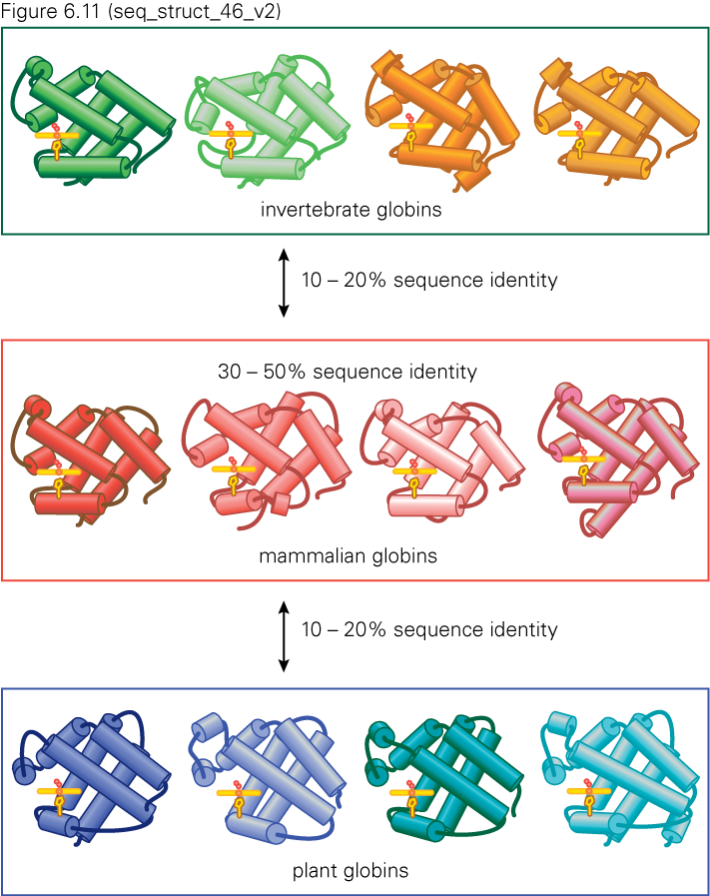
Structure vs. sequence conservation
Protein sequence determines its structure
But the reciprocal is not the case: the “same” structure (i.e. fold) can be generated from very different sequences
Figure from The Molecules of Life (© Garland Science 2008)

Slide 10
Learning goal and objectives
Learning Goal: To understand how structural and biochemical data can be used to rationally design drugs.
Learning Objectives:
Be able to:
Explain how we quantitatively describe “structural similarity”
Distinguish “competitive” vs “noncompetitive” enzyme inhibition (structurally and biochemically)
Use enzymatic kinetic data to determine which inhibitors would combine to make the best drug cocktail
Notes:
→ Drug design

Slide 11
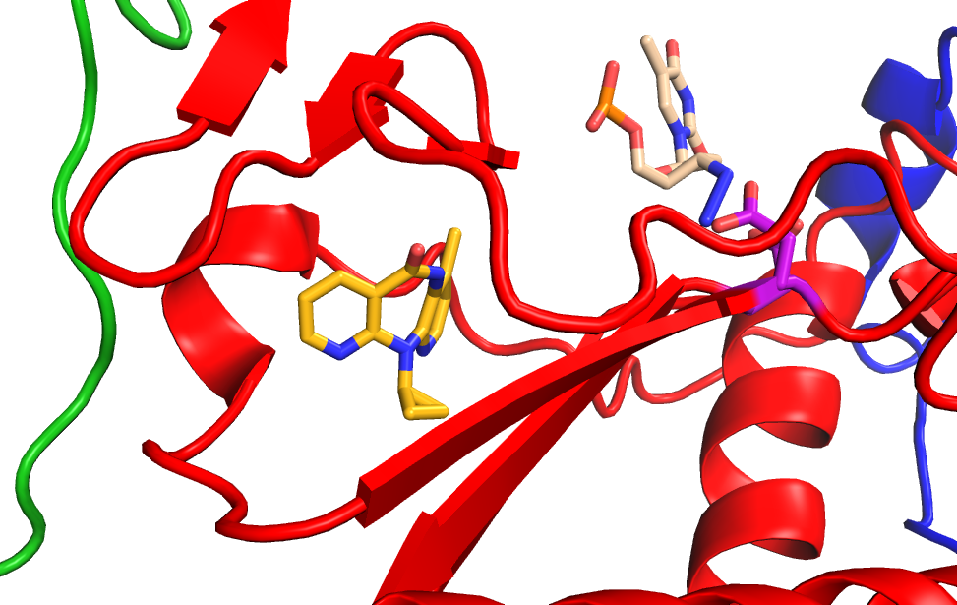
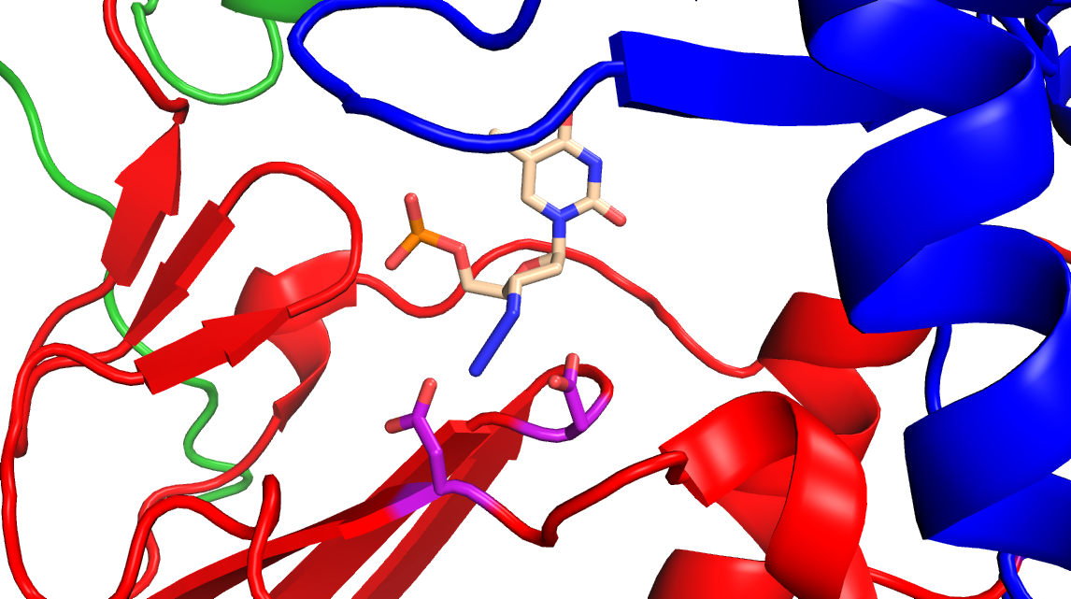
Competitive vs Noncompetitive inhibitors
AZT
AZT
Neviprine
Competitive drug
Binds the active site, blocking substrate from entering
Noncompetitive drug
binds away from the active site but interfere with catalysis
DNAP_RT.pse

Slide 12
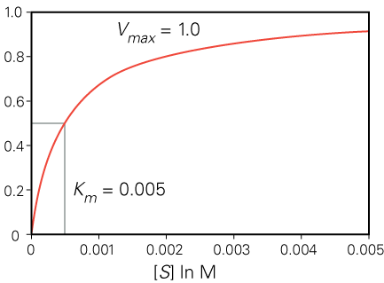
How do we measure enzymatic rates?
Experiment: use a small amount of enzyme, measure how quickly product is produced at several different substrate concentrations
~linear at low [S]
Plateaus at high [S]
maximum = V_{max}
K_{M} = [S] where v = V_{max}/2
rate
in
Figure from The Molecules of Life (© Garland Science 2013)
Notes:
Velocity of the reaction = rate of product formation.
Vmax = the maximum rate of reaction catalyzed by an enzyme at very high substrate concentration.
Rate of back reaction very slow = ignored; rate of product formation is called the “velocity of the reaction” (v)
Vo = initial velocity, before substrate is depleted, linear
Vmax= rate enzyme levels off at with saturating [S]
We talked on Friday about how the concentration dependence of the rate of an enzyme-catalyzed reaction resembles the thermodynamics of ligand binding, that is because the first step in enzyme catalysis is the binding of substrate to the enzyme….

Slide 13
To distinguish between types of enzyme inhibition, we need to make a “double reciprocal graph”

Slide 14
Measure rates at different substrate concentrations
Display on a double reciprocal plot
Notes:
Now we have established a basic toolset, the MM equation and the lineweaver-Burke plot, to study simple enzyme reactions. We’ll see how we can put these in practice to study how enzymes are inhibited.
“Data points – push to back for pre-lecture notes – I put a big, big white dot to the right of the graph as a “handle” to find the points when they are hidden behind the plot.

Slide 15
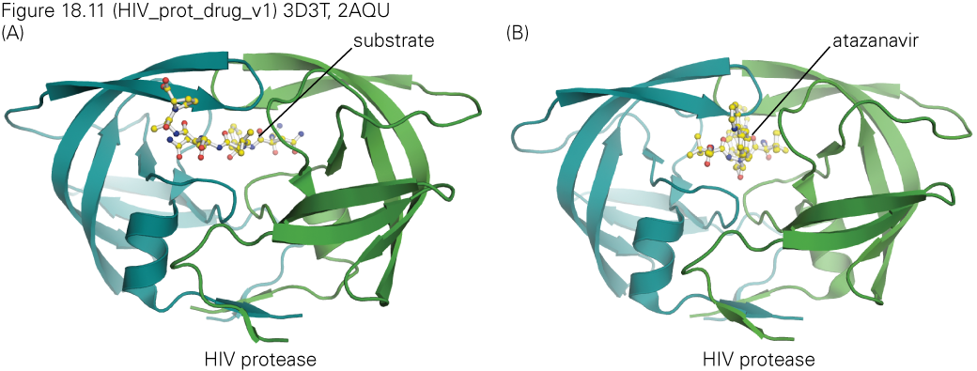
Competitive inhibition
Increasing [I]
Increasing [I]
Competitive inhibitors bind to the enzyme’s active site

Slide 16
Noncompetitive inhibitors
Increasing [I]
Noncompetitive inhibitors bind to the enzyme away from the active site

Slide 17
Summary:competitive vs noncompetitive
Competitive
Displace the substrate through reversible binding to the active site
Noncompetitive
Bind away from the active site, indirectly interfering with catalysis

Slide 18
Concept check
Kinetic analysis of an enzyme binding to substrate A and two inhibitors gives the results shown in the following graphs. Which inhibitor is competitive, which is noncompetitive?
Inhibitor a Inhibitor b
A is noncompetitive; B is competitive

Slide 19
Drug cocktails
For rapidly evolving diseases (virus, bacteria, cancer), treatment with one drug alone allows for the disease to evolve resistance to the drug
Drug cocktails are combinations of several drugs, including multiple drugs that hit the same enzyme but in different ways
Harder to evolve resistance to two drugs that bind to different sites of an enzyme simultaneously AND retain function
Best drug cocktails combine competitive and noncompetitive inhibitors
Given the data provided to you, which drug cocktail do you think will be most effective?
Drugs 1+2
Drugs 1+3
Drugs 2+3

Slide 20
Learning goal and objectives
Learning Goal: To understand how structural and biochemical data can be used to rationally design drugs.
Learning Objectives:
Be able to:
Explain how we quantitatively describe “structural similarity”
Distinguish “competitive” vs “noncompetitive” enzyme inhibition (structurally and biochemically)
Use enzymatic kinetic data to determine which inhibitors would combine to make the best drug cocktail
Notes:
→ Drug design

Slide 21
Additional considerations in drug design and testing
DNA polymerase
Toxicity
Drug has to inactivate pathogenic enzymes, but not ours
Bioavailabilty
Biostabilty
Economics
HIV Rev Transcriptase
Inactive or toxic

