Slide 1
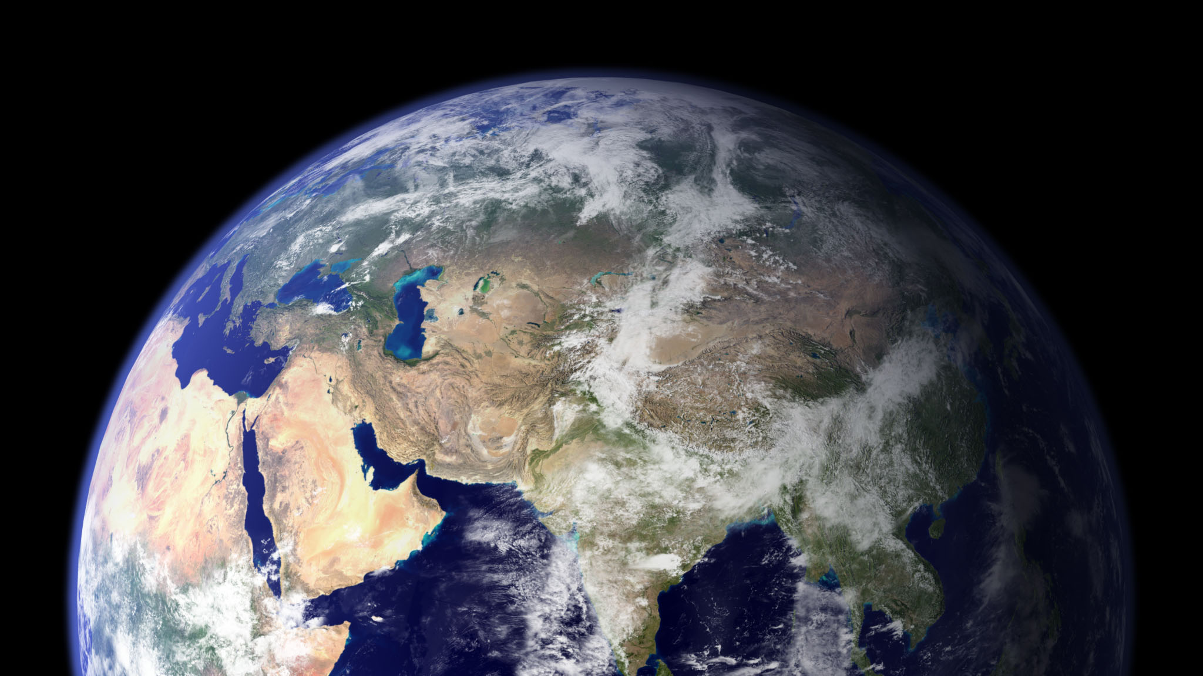
Eddy Covariance Data & Terrestrial Biosphere Models
Miriam Johnston
4th-year PhD student,
Organismic & Evolutionary Biology
mjohnston@g.Harvard.edu

Slide 2
Eddy Covariance Data & Terrestrial Biosphere Models
Miriam Johnston
4th-year PhD student,
Organismic & Evolutionary Biology
mjohnston@g.Harvard.edu
What tools and data do we use to understand and predict
ecosystem processes over space and time?
Notes:
This entire lesson aims to answer this one very dense question: __
In other words: we make all sorts of predictions about the how continents and/or the globe will respond to climate change & how ecosystems feed back onto climate – what the heck are these based on?

Slide 3
What tools and data do we use to understand and predict
ecosystem processes over space and time?
What are ecosystem processes?
Notes:
First of all, let’s get on the same page about ecosystems. What are ecosystem processes?

Slide 4
CARBON
WATER
What are ecosystem processes?
ENERGY
NUTRIENTS
Notes:
Most ecosystem processes have something to do with these 4 entities.

Slide 5
CARBON
What are ecosystem processes?
Notes:
Let’s consider them more in-depth, carbon first. [ACTIVITY]: If I asked you about all the things that might influence the C cycle, what could we consider?

Slide 6
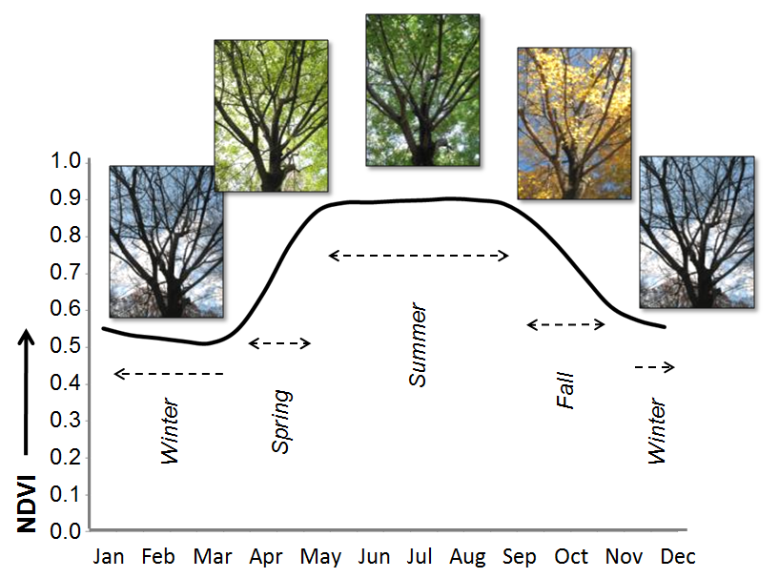
CARBON
Phenology
Greenness
Notes:
Momentum = mass * velocity (in kg*m / s)
Coupled vs. not: which variables are given vs. coming from other models?

Slide 7
WATER
What are ecosystem processes?

Slide 8
WATER
Notes:
You can kind of tell I usually think more about plants…

Slide 9
What are ecosystem processes?
ENERGY

Slide 10
ENERGY
Notes:
(and we’ll skip nutrients for now, since this is at the frontier of these models, global cycles are not particularly well constrained, data are difficult to come by)

Slide 11
CARBON
WATER
What are ecosystem processes?
ENERGY
NUTRIENTS
Notes:
So let’s say we write down equations for all of these things we considered.
For C3 photosynthesis! For transpiration! For energy balance! – I did this for much of the plant-relevant stuff when I was preparing for my qualifying exam
We quickly realize that all these processes are linked (aka coupled).

Slide 12
CARBON
WATER
What are ecosystem processes?
ENERGY
NUTRIENTS
Notes:
We can also see that the links have the potential to be numerous, conditional, and varied, depending on forcings = things like weather, what plant you are, etc.
We need some sort of formalized structure to keep track of these things & the way they interact.
So we put all these equations into one gigantic model of how an ecosystem works – a terrestrial biosphere model!
[Which may then be coupled with an atmospheric model…]

Slide 13
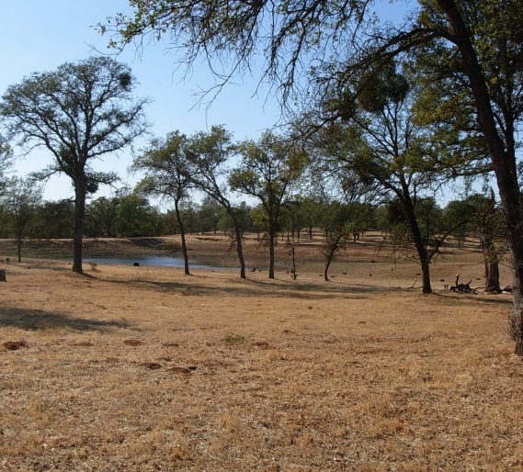
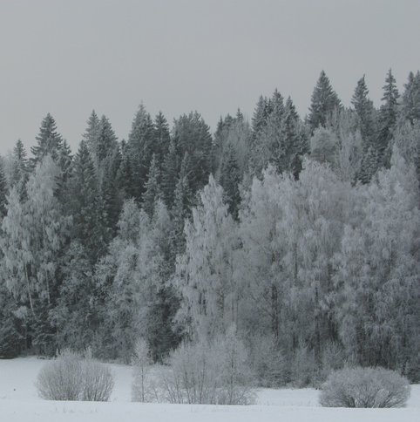
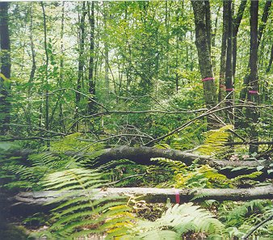
Notes:
Here’s my model; each box is a function/subroutine or a script. And when you run it, you really do get ecosystem functioning!

Slide 14
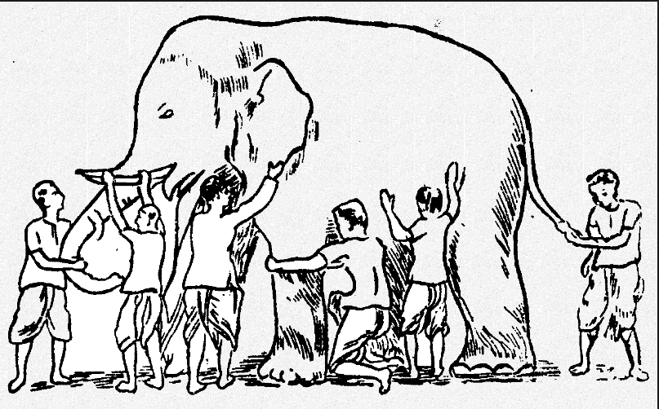
What is a terrestrial biosphere model?
→ Our best working hypothesis about the quantitative functioning of terrestrial ecosystems
Notes:
Now’s the time to bring in my favorite ecosystem model analogy and my favorite ecosystem model quote.
The parable of the 6 blind men and the elephant – what is it? Spear, paper, trunk of a tree, thick snake, rope, wall.
It’s only when the blind men work together that they can see that it’s an elephant
→ Only when we consider processes in tandem that we can model ecosystems

Slide 15
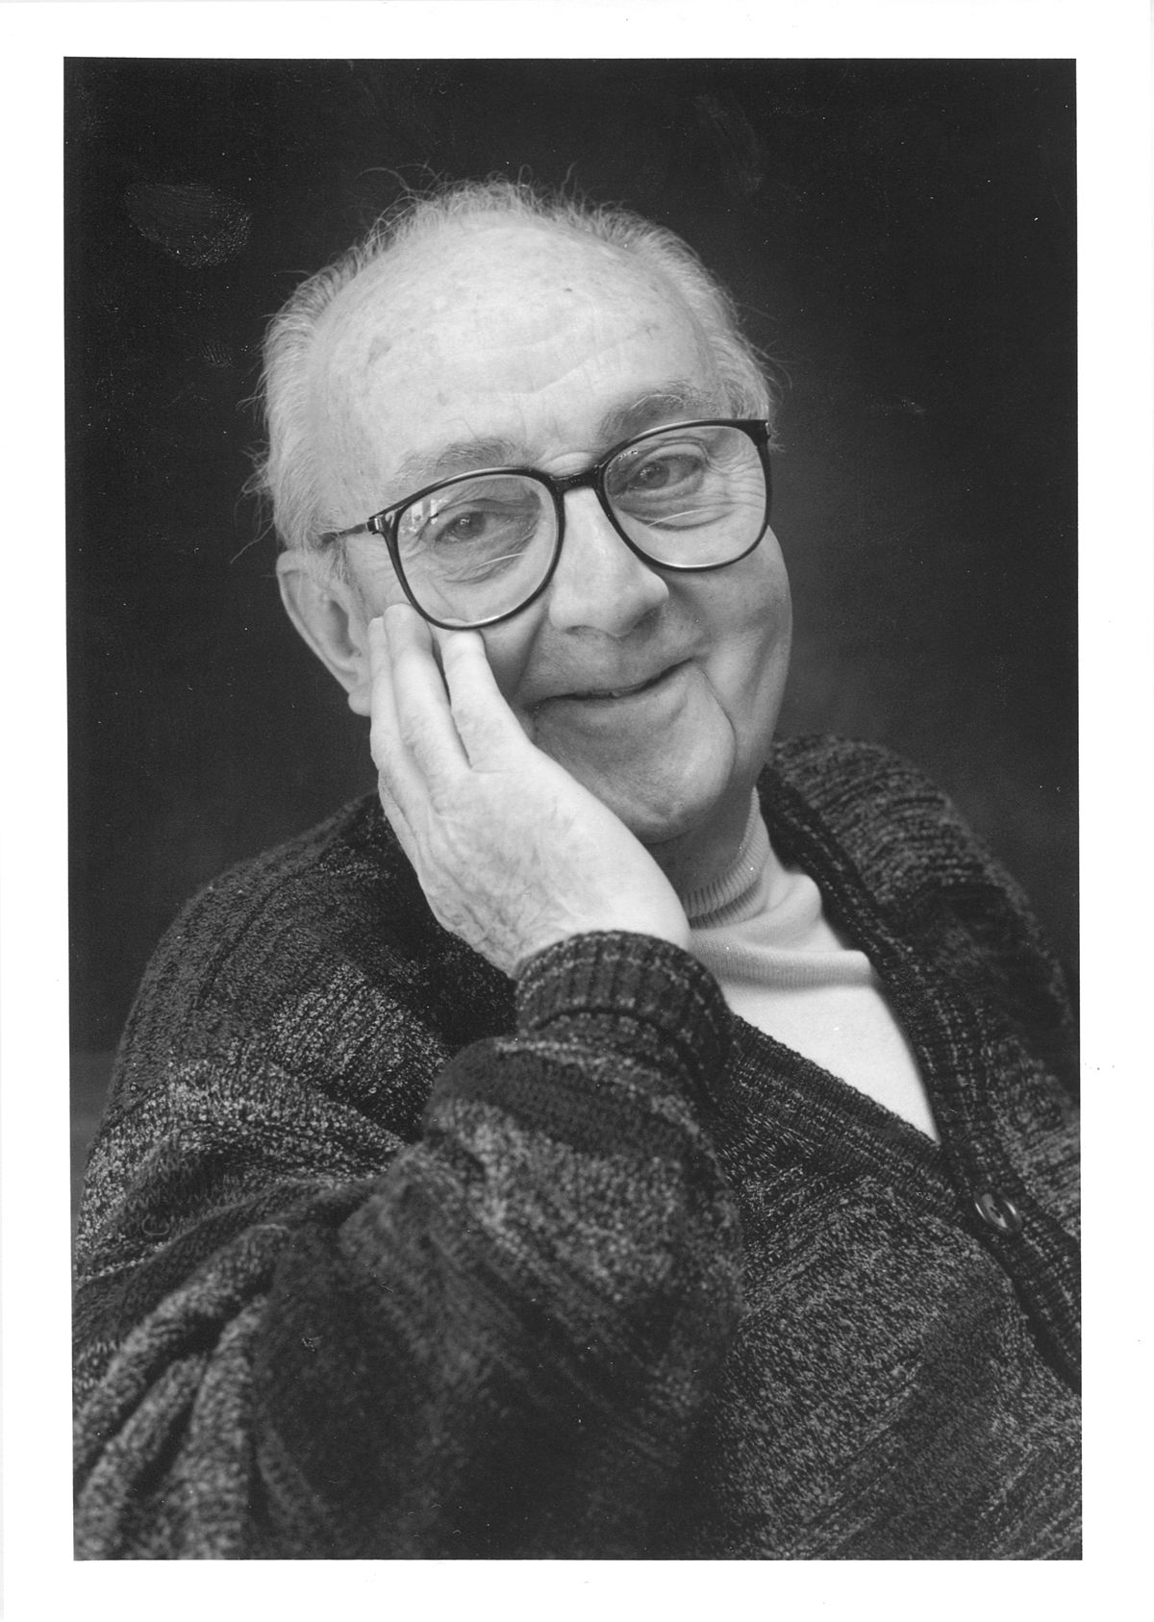
What is a terrestrial biosphere model?
→ Our best working hypothesis about the quantitative functioning of terrestrial ecosystems
“All models are wrong,
but some are useful”
- George Box, 1978
Notes:
The famous quote from British statistician George Box

Slide 16
What tools and data do we use to understand and predict
ecosystem processes over space and time?
Notes:
Revisiting our ultimate goal here

Slide 17
What tools and data do we use to understand and predict
ecosystem processes over space and time?
Terrestrial Biosphere Models
Notes:
We’ve been talking about these models, which are, again (loftily) “our best hypothesis of how the natural world works” or:
“a bazillion coupled equations and contingency statements coded up & (usually) run on a supercomputer.”

Slide 18
What tools and data do we use to understand and predict
ecosystem processes over space and time?
Terrestrial Biosphere Models
Greenness
Notes:
Here is just a mini of the processes that we hashed through at the beginning of this session

Slide 19
What tools and data do we use to understand and predict
ecosystem processes over space and time?
What’s the effect of deforestation in the Amazon?
Will warming in the Arctic result in ecosystem state shifts?
How will prolonged drought in California affect ecosystem structure & function?
Terrestrial Biosphere Models
Greenness
Notes:
But also, because we have, in theory, our best hypothesis of how the entire system works, we can also ask questions that require a more integrated understanding of the system.

Slide 20
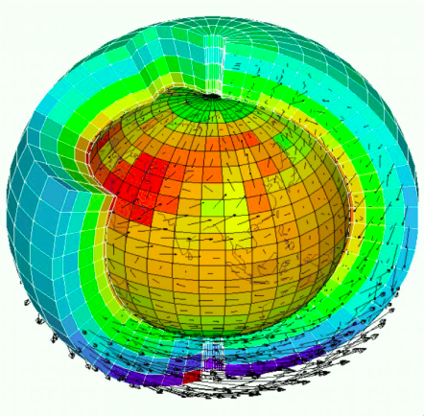
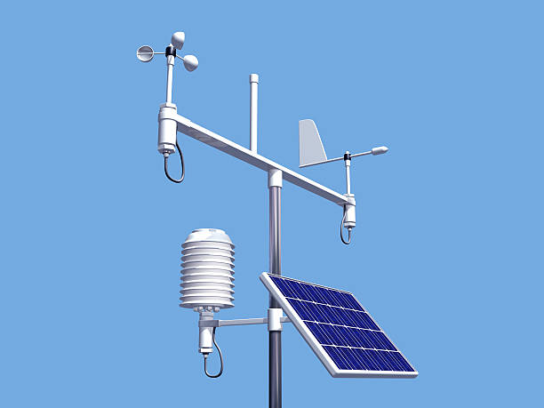
What tools and data do we use to understand and predict
ecosystem processes over space and time?
Input Data
Meteorology (weather)
Soil characteristics
Seasonal cycle timing
Initial vegetation state
(sometimes)
Notes:
What about the data part?? These models are often gigantic, but how do we know if they’re right? And do they come up with ‘answers’ from nothing?
Data, which scientists & their instrumentation collect, show up in these models in 2 main ways:
Input data
Validation and/or ‘tuning’ data
Here’s input data, just to give a sense, but not going to talk much about it, because this is external to the modeling itself.

Slide 21
What tools and data do we use to understand and predict
ecosystem processes over space and time?
Input Data
Meteorology (weather)
Soil characteristics
Seasonal cycle timing
Initial vegetation state
(sometimes)
Validation/Tuning Data
Carbon fluxes
Water fluxes
Energy fluxes
Plant demography
Anything the model predicts!
Notes:
What about the data part?? These models are often gigantic, but how do we know if they’re right? And do they come up with ‘answers’ from nothing?
Data, which scientists & their instrumentation collect, show up in these models in 2 main ways:
Input data
Validation and/or ‘tuning’ data
Here’s input data, just to give a sense, but not going to talk much about it, because this is external to the modeling itself.

Slide 22
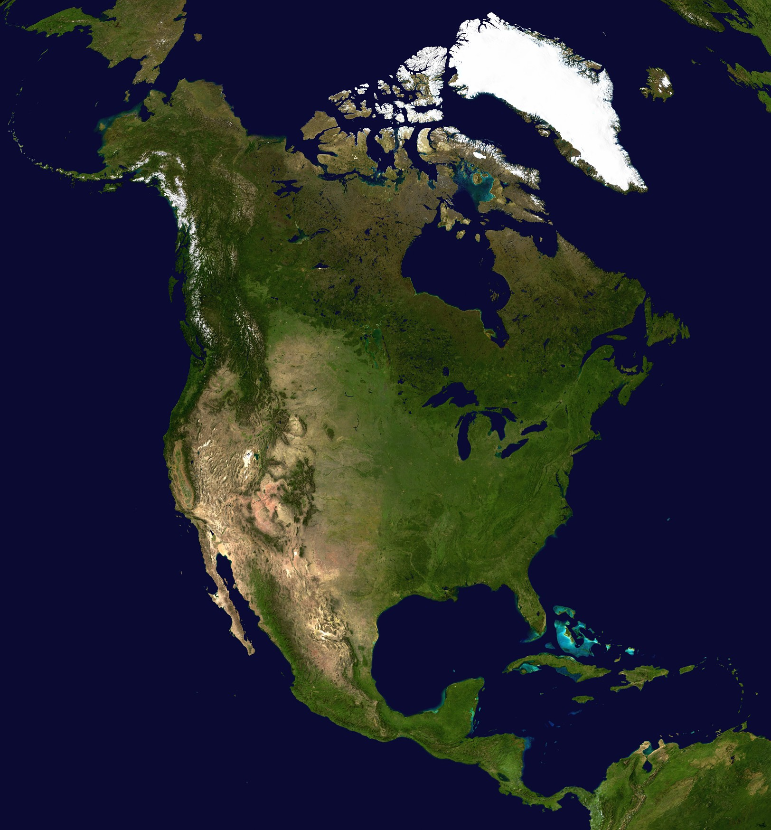
How are terrestrial biosphere models validated?
?
Notes:
So these models are important & have lots of applications, but remember George Box.
All models are wrong – but how do we know if these models are useful?
Clearly, there’s a scale mismatch here (models may be as coarse as 1 degree = 100 km or may be much finer-scaled
Specify degrees CELSIUS

Slide 23
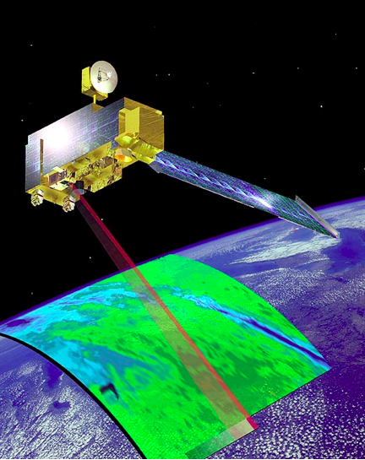
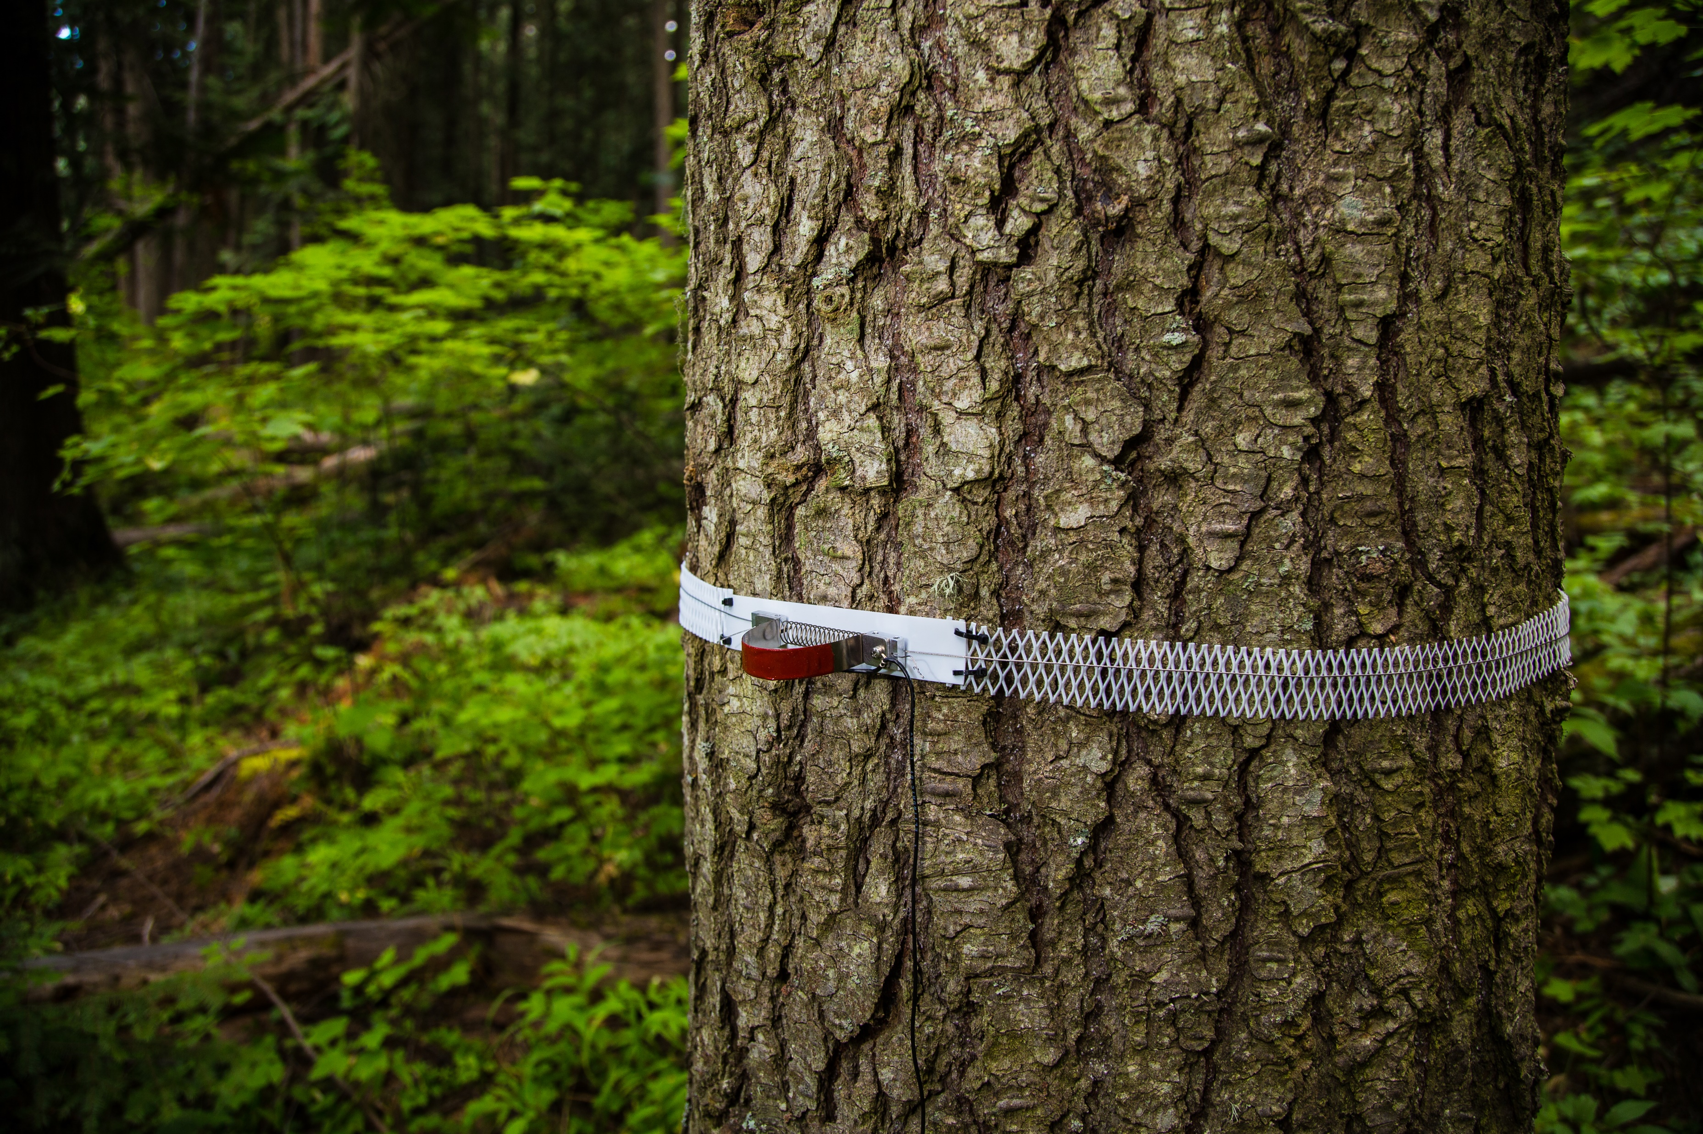
How are terrestrial biosphere models validated?
Notes:
Anything that measures something predicted by a model

Slide 24
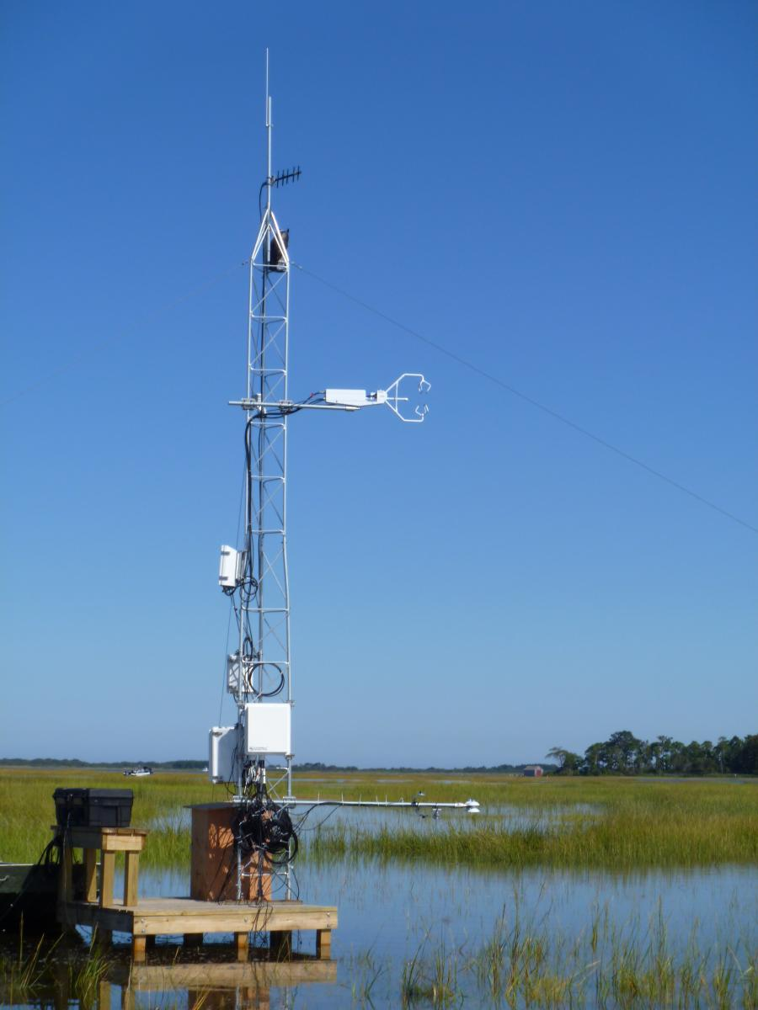
How are terrestrial biosphere models validated?
Notes:
This is one of the most common sources of validation data! Measures something that integrates lots of processes over relatively large areas.
Now: we’re transitioning to focusing on eddy flux data as a really important source of validation data for TBMs and, importantly, as a source of information in its own right. This is the data activity we’ll be working on.
[Click the photo for the NEON video]

Slide 25
Notes:
Extensive network

Slide 26
Objective: visualize net carbon fluxes at multiple time scales and in varied ecosystems using eddy covariance data
Notes:
Extensive network

Slide 27
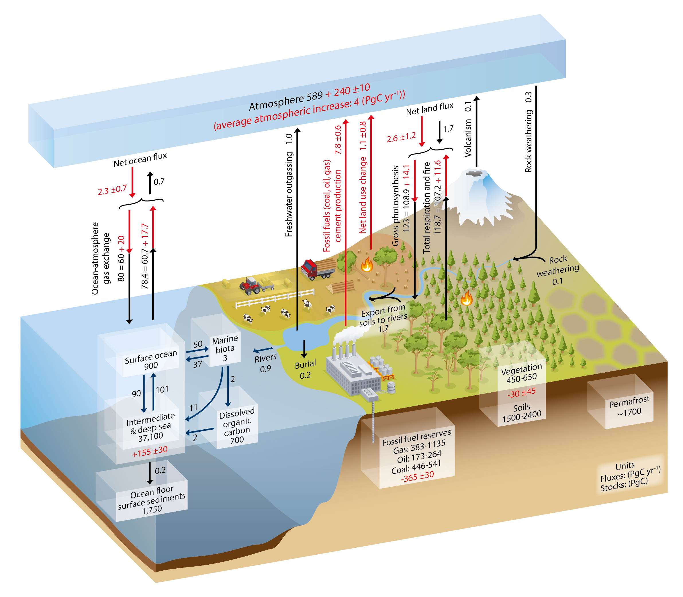
Global Carbon Fluxes
Fossil Fuels:
7.8 +/- 0.06 Pg C / globe / yr
Gross Photosynthesis:
123 Pg C / globe / yr
Total respiration & fire:
118.7 Pg C / globe / yr
IPCC
Notes:
Just to give you an idea of the general context and numbers for global carbon flux
1 Pg = a quadrillion grams
1 Pg = 10^12 kg = 10^15 g

Slide 28
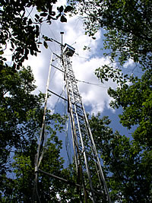
Let’s use eddy flux data to:
Distinguish ecosystem and vegetation types
Determine whether ecosystems are net sources or sinks for carbon
Visualize climate change

Slide 29
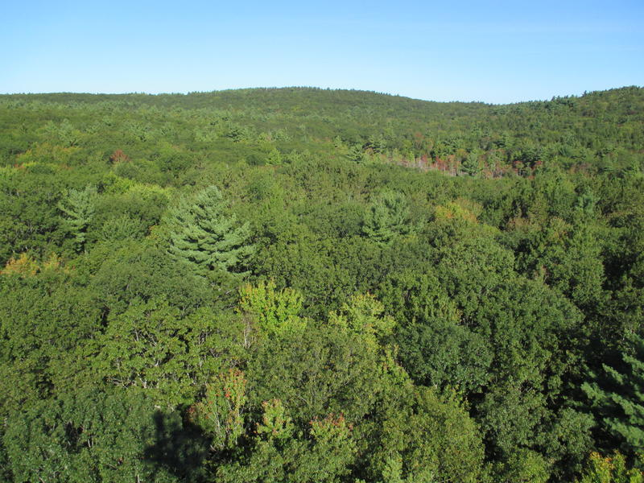
FLUX DATA ACTIVITY #1a: Can you distinguish these ecosystems based on their diurnal and/or seasonal carbon fluxes?
Tapajos National Forest, Brazil Barrow, Alaska Petersham, MA
Notes:
Plot diurnal & seasonal C fluxes
What are some challenges? [NAs, lots of data to look at]

Slide 30
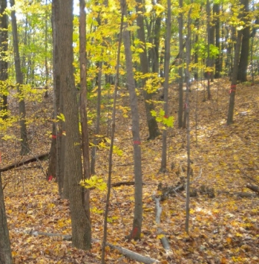
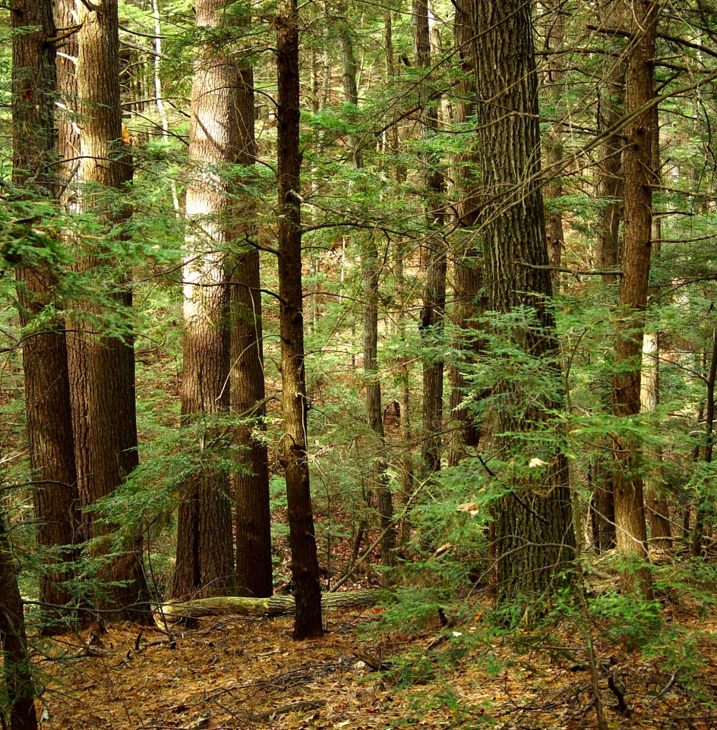
FLUX DATA ACTIVITY #1b: What is the difference between carbon fluxes of mid-latitude deciduous vs. coniferous trees?

Slide 31
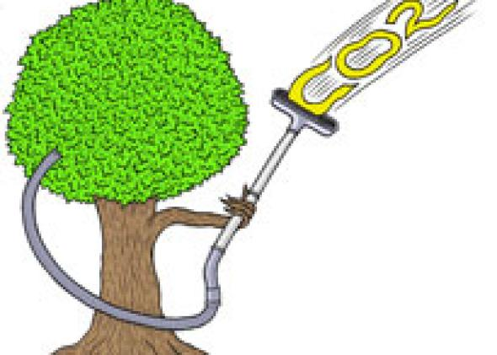
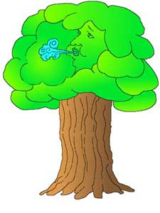
FLUX DATA ACTIVITY #2: Is the Harvard Forest deciduous ecosystem a net carbon source or sink?

Slide 32
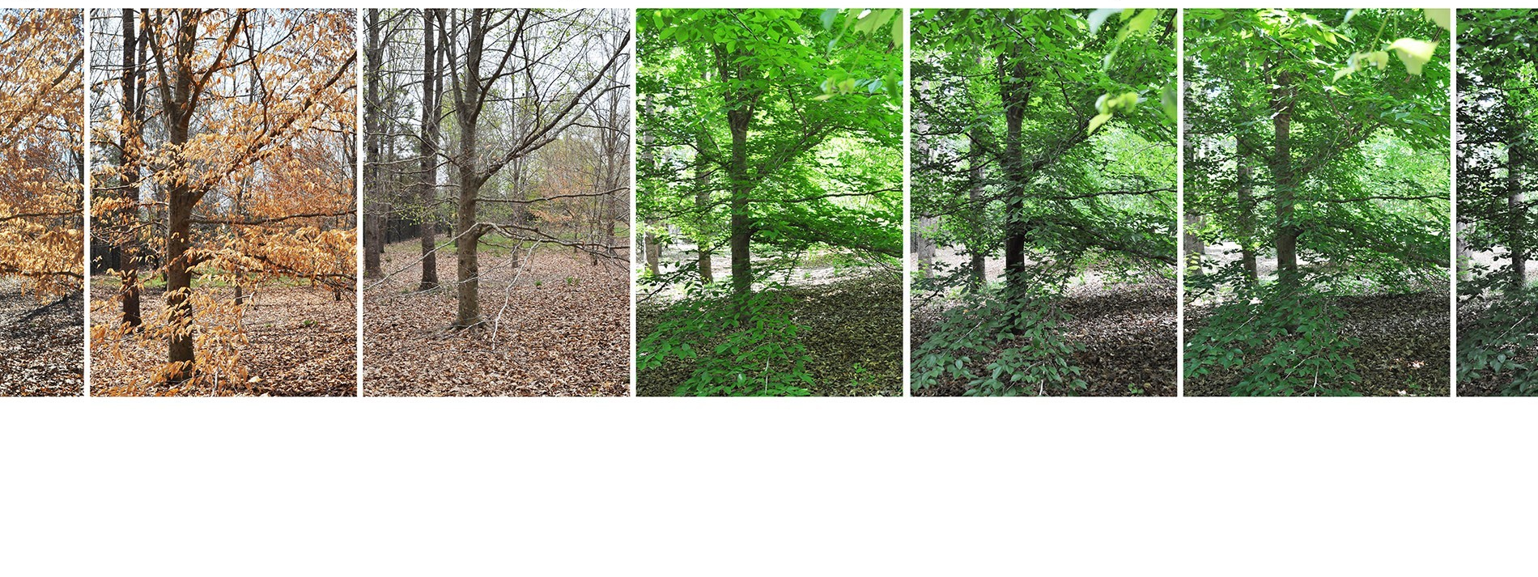
FLUX DATA ACTIVITY #3: Has the timing of green-up changed in the last 25 years at Harvard Forest?

Slide 33
Wrap-Up
What tools and data do we use to understand and predict
ecosystem processes over space and time?
Objective: visualize net carbon fluxes at multiple time scales and in varied ecosystems using eddy covariance data

Slide 34
Wrap-Up
Thank you!
Questions?
Miriam Johnston
4th-year PhD student,
Organismic & Evolutionary Biology
mjohnston@g.Harvard.edu

